Slide 1
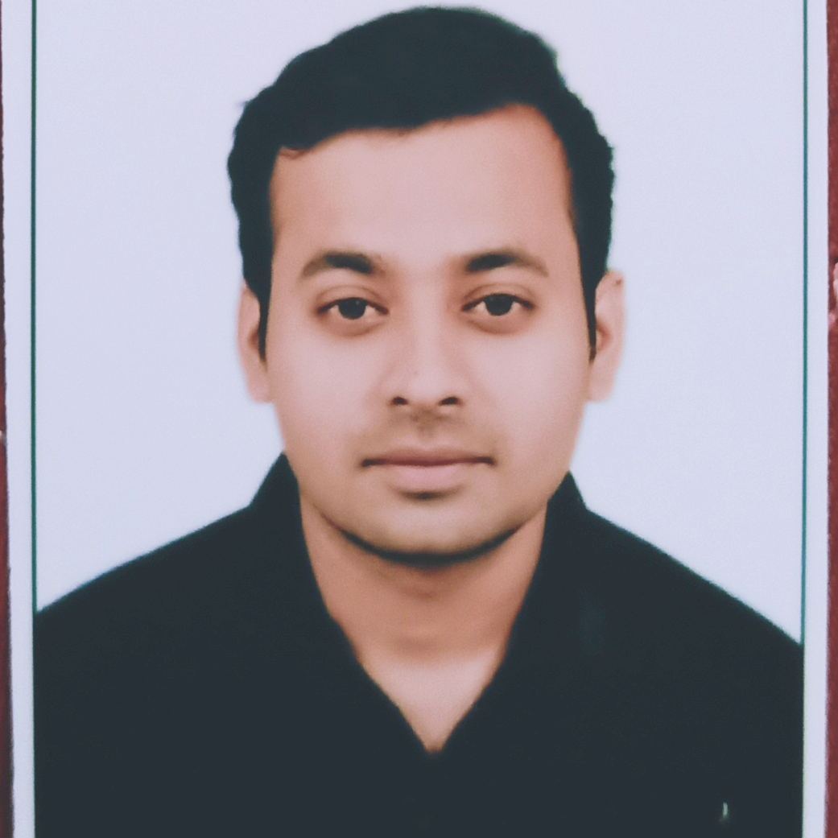
SUNNY KUMAR
Engineering Innovation, Driving Excellence – From Concept to Mass Production.
(Automobile Component design and development)

Slide 2
Core Strengths
Quick Learner & Adaptive Thinker
Fast at grasping new technologies, tools, and industry trends, ensuring continuous improvement and innovation in mechanical design and development.
Tech Enthusiast & Innovation-Driven
Passionate about emerging technologies in the automotive industry, including advancements in electric vehicles, materials, and manufacturing techniques.
Strong Analytical & Problem-Solving Skills
Proficient in identifying design challenges and implementing effective solutions to enhance performance, durability, and cost-efficiency.
Detail-Oriented & Quality-Focused
Committed to precision and accuracy in mechanical design, ensuring that every component meets high-quality standards and industry regulations.
Effective Team Player & Collaborator
Thrives in cross-functional environments, working seamlessly with engineers, suppliers, and stakeholders to achieve project goals efficiently.
Leadership & Decision-Making
Capable of making data-driven decisions, leading projects, and guiding teams toward successful product development and mass production.

Slide 3
Experience
Senior Design Engineer l TATA ELXSI LTD (JAGUAR LAND ROVER Project) - (2023 - Present)
Design Engineer l TATA ELXSI LTD (JAGUAR LAND ROVER Project) - (2022 – 2023)
Create concept and detailed design (2D/3D) along with supporting calculations and tolerance stack ups.
Requirement and test cases planning and management, Design Validation plan.
Advance product quality planning , Product lifecycle management, Component technical deliveries planning.
Product Life cycle management, Risk and Change management.
Prepared FMEA, ESOW, RFQ, PDS (Product design specification) and checking/approving supplier engineering documents
Different Design Release, Production and Tooling releases.
Risk and Change management, Pre-production approval process completion.
Worked in Agile methodology with all cross functional teams (Manufacturing, quality, service, integration etc.)
Milestone and Technical gateway planning with alignment from stakeholders.
Project Planning and management at components level of a vehicle
Integration of Electric Drive unit and its components.
Risk Assessment: Identify potential risks and devise mitigation strategies.
Optimize & validate mechanical designs using appropriate modelling, simulation, and analysis tools.
Graduate Engineer Trainee | METALMAN AUTO PVT LTD - (2020 – 2021)
Worked in Production Planning and Control Department as well as in production dept.
Sheet metal parts manufacturing using different press machines, Monitoring production as well as quality of the parts.
Minimize the production time loss, supply chain management.

Slide 4
PORTFOLIO

Slide 5
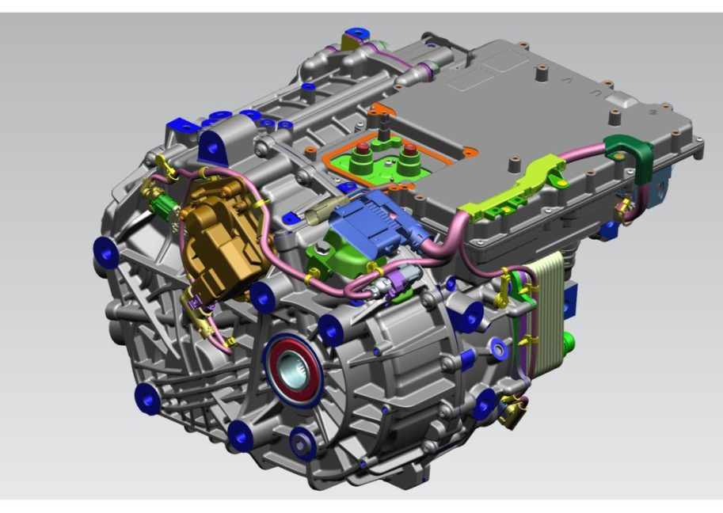
Electric Drive unit Casted components
High-Pressure Die-Cast (HPDC) Component Development for Electric Drive Unit (EDU)
Led the end-to-end development of an HPDC-casted component for an Electric Drive Unit (EDU) from concept to mass production.
Executed complete mechanical design and development, including 3D modeling, 2D detailing, and tolerance analysis.
Conducted DFMEA to identify and mitigate potential failure modes, ensuring robust design.
Managed PLM (Product Lifecycle Management) processes, engineering releases, and risk assessments for seamless project execution.
Planned and delivered key component engineering milestones, including design validation, supplier coordination, and manufacturing feasibility analysis.
Ensured successful mass production readiness, meeting quality, cost, and performance targets.

Slide 6
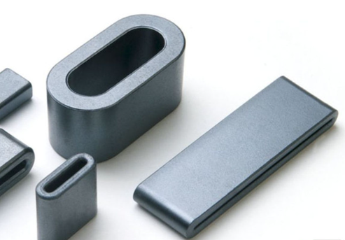
Common Mode Choke Development for Inverter Busbar in Electric Drive Unit (EDU)
Led the complete development of a common mode choke (CMC) for the inverter busbar in an Electric Drive Unit (EDU) from concept to mass production.
Designed and optimized the CMC structure, ensuring effective electromagnetic interference (EMI) suppression while meeting packaging constraints.
Executed comprehensive mechanical design, including 3D modeling, 2D detailing, and material selection for optimal performance.
Conducted DFMEA to assess and mitigate potential failure modes, improving component reliability.
Managed PLM (Product Lifecycle Management), engineering releases, and risk assessments to ensure smooth project execution.
Developed and implemented a design validation plan, coordinating with suppliers and testing teams to ensure compliance with performance requirements.
Successfully delivered the CMC for mass production, meeting quality, cost, and performance targets for high-volume automotive manufacturing.

Slide 7
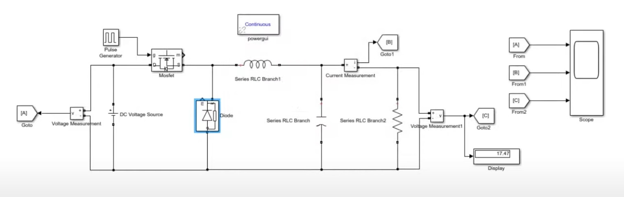
Buck Converter
Developed a buck converter model in Simulink to step down DC voltage efficiently, ensuring stable output regulation.
Designed and simulated key components, including MOSFET switching, inductor, diode, and capacitor, to analyse performance under varying load conditions.
Implemented PWM control strategy to regulate output voltage with high efficiency.
Conducted simulations to evaluate voltage ripple, efficiency, transient response, and stability of the system.
Optimized component values to enhance power conversion efficiency and minimize losses.

Slide 8
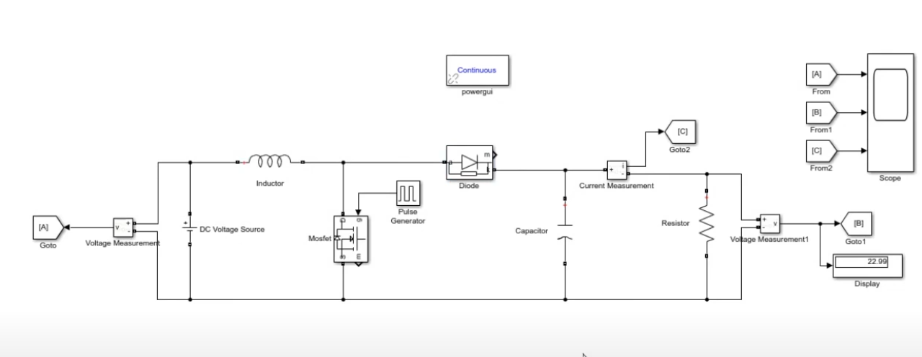
Boost Converter
Boost Converter Simulation in Simulink
Designed and simulated a boost converter model in Simulink to step up DC voltage efficiently while maintaining system stability.
Integrated key components such as MOSFET switch, inductor, diode, and capacitor, ensuring smooth power conversion.
Implemented PWM-based control strategy to regulate output voltage and improve efficiency.
Analyzed voltage ripple, transient response, and efficiency under varying load and input conditions.
Optimized component selection to minimize power losses and enhance overall performance.

Slide 9
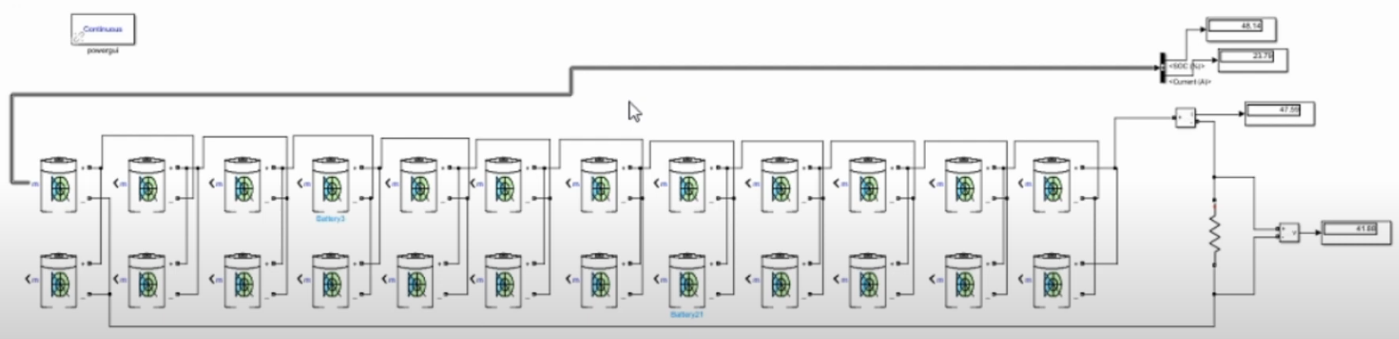
Simple Battery Pack Simulation in Simulink
Designed a basic battery pack model using 3.7V cells arranged in series and parallel to achieve the desired voltage and capacity.
Simulated the pack under various load conditions to analyze voltage, current, and state of charge (SOC) variations.
Integrated a measurement setup with scopes to monitor real-time performance of the battery pack.
Evaluated the impact of load variations on battery discharge characteristics.

Slide 10
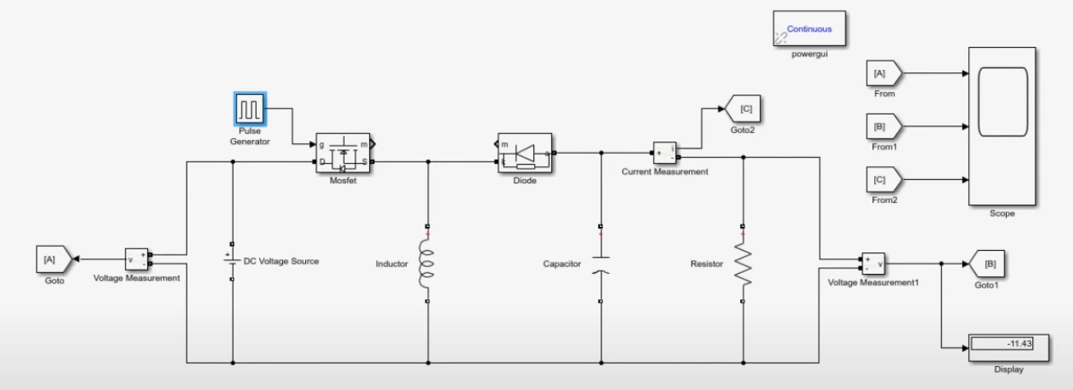
Buck-Boost Converter
Developed a buck-boost converter model in Simulink to regulate DC voltage for both step-up and step-down applications.
Integrated key components such as MOSFET switch, inductor, diode, and capacitor to achieve efficient power conversion.
Implemented PWM-based control to dynamically adjust output voltage based on input variations.
Simulated and analyzed voltage, current, and state of charge (SOC) behavior under different load conditions.
Evaluated converter performance in terms of voltage regulation and system response.

